Slide 1
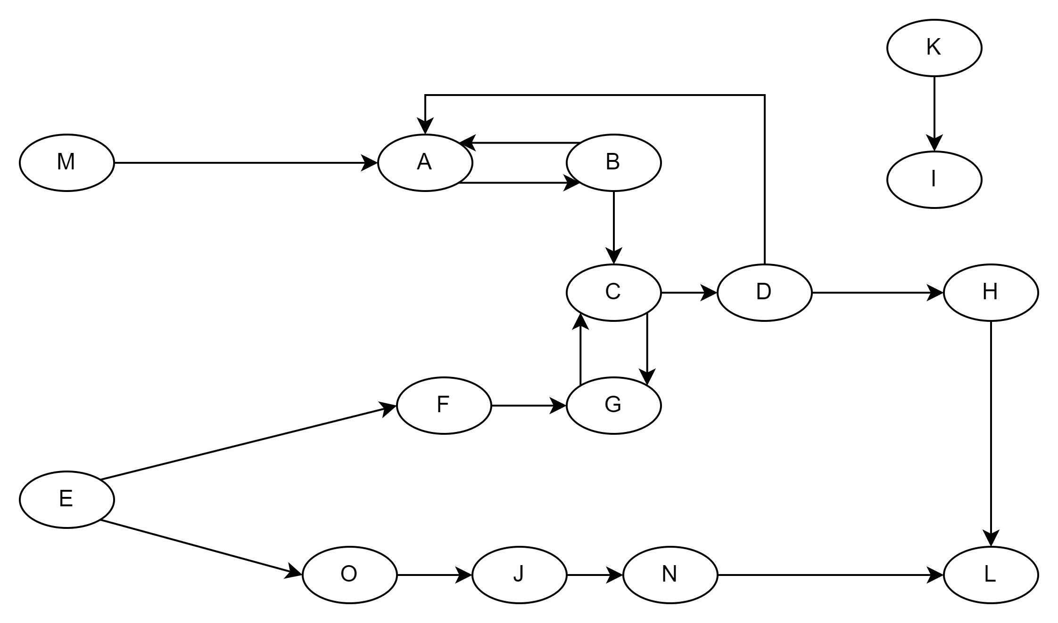
INN
SCC
OUT
TENDRIL
TUBE
DISCONNECTED

